Slide 1
Data Science Hackathon
upGrad Datascience bootcamp
Topic: E-Commerce product categorization
Submitted by
Anju mohan
Data science bootcamp- jan 15 batch

Slide 2
E-commerce Product Categorization
In the rapidly evolving world of eCommerce, accurate product categorization is crucial for ensuring seamless customer experiences, reducing search friction, and increasing product discoverability. However, the sheer volume of diverse products poses a significant challenge. Current classification systems struggle to handle ambiguities, unconventional naming conventions, and multi-language data. This hackathon aims to address these challenges by inviting participants to create innovative solutions that enhance product categorization efficiency, accuracy, and scalability.
Develop a text classification model that categorizes products with maximum accuracy based on description of the product.
The hackathon aims to deliver innovative product categorization models that enhance customer experience, product discoverability, and business revenue while providing deployment-ready solutions for immediate impact.

Slide 3
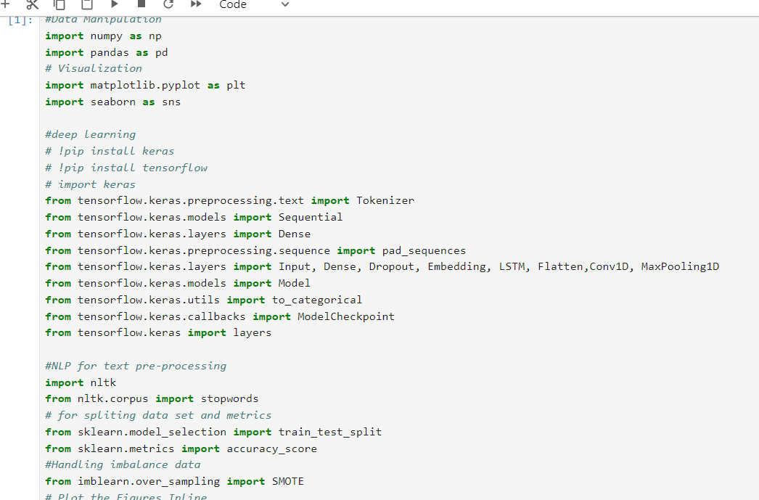
Importing libraries

Slide 4
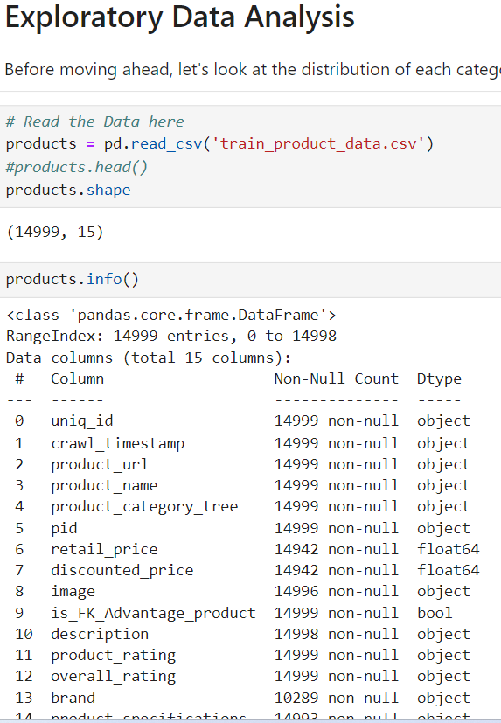
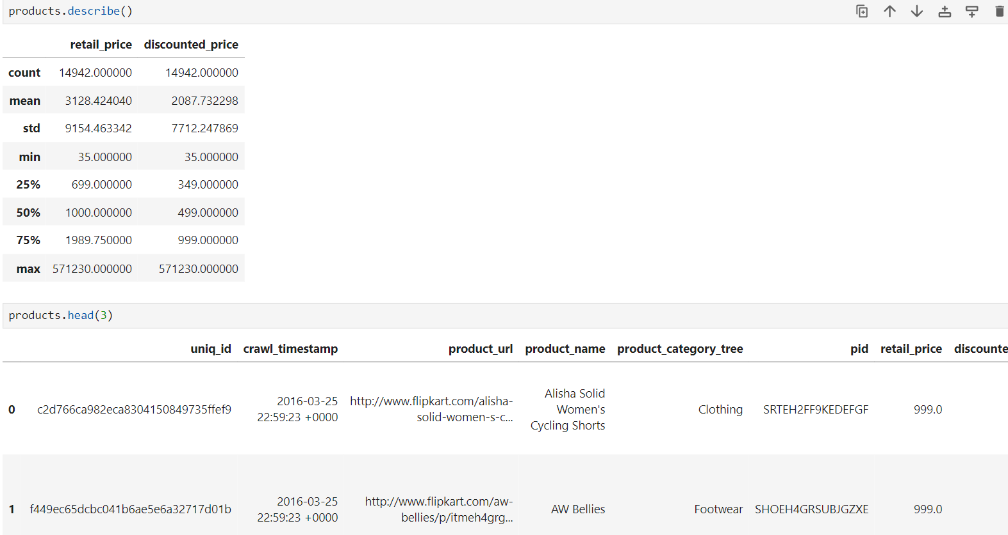
Exploratory Data Analysis

Slide 5
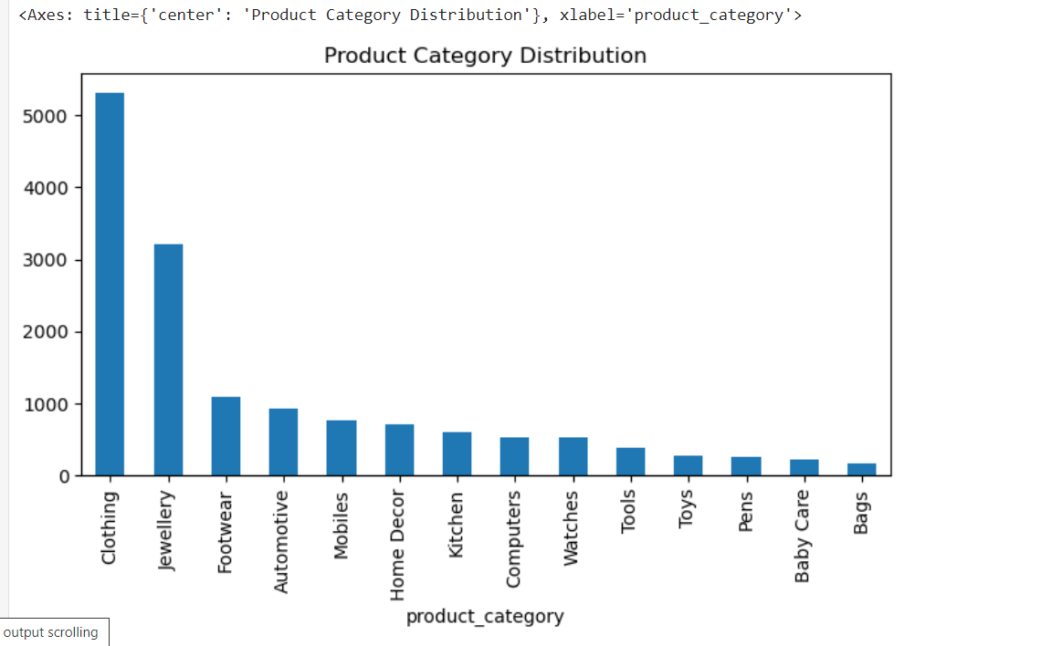
Data Visualisation

Slide 6
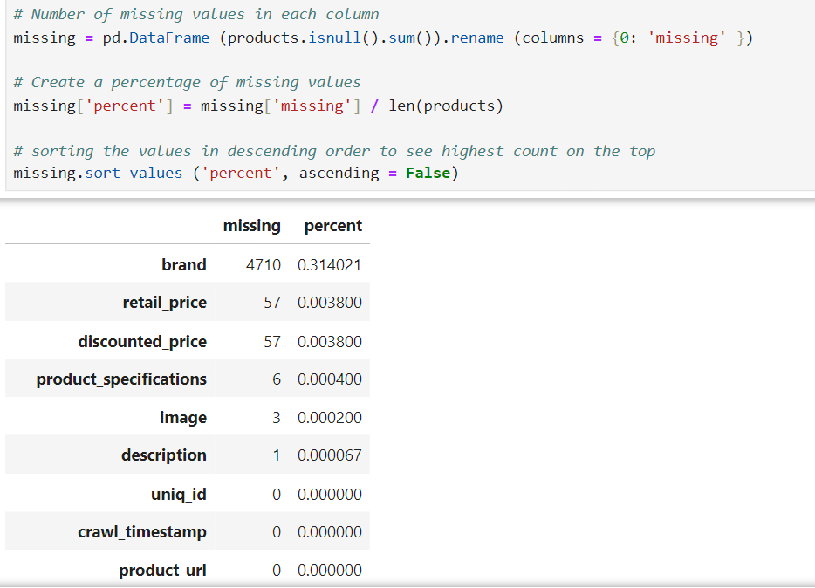
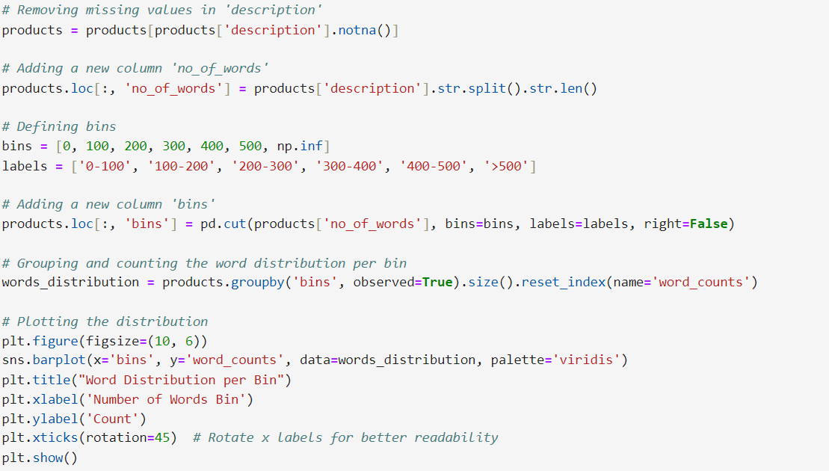
Data Preprocessing

Slide 7
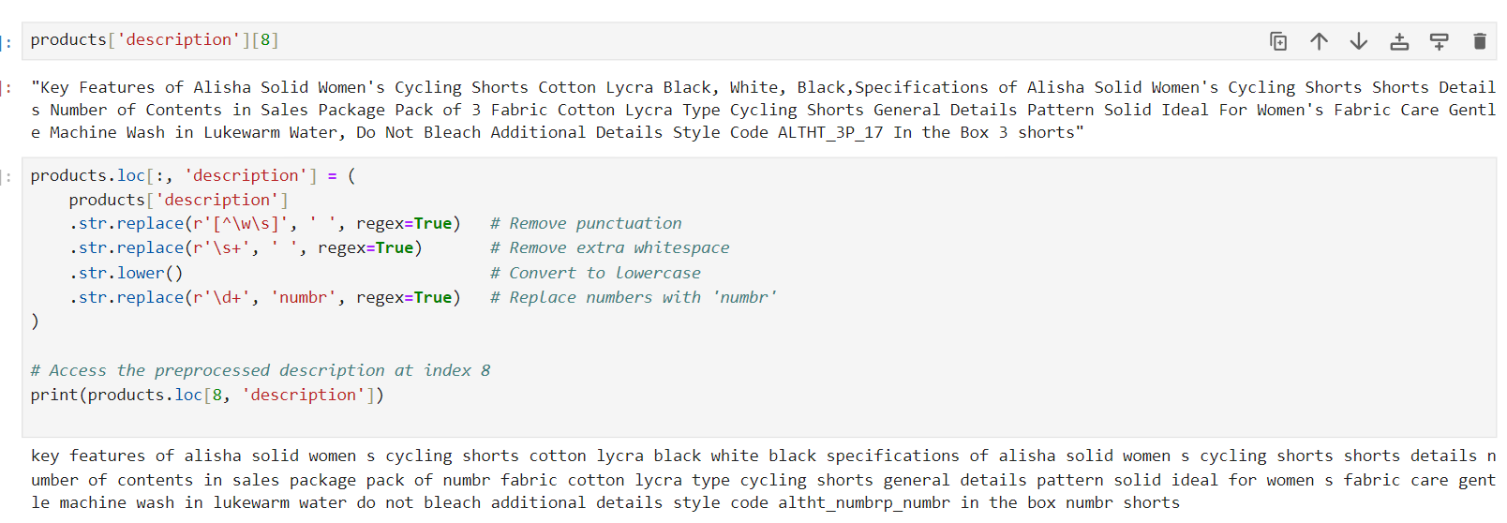
Text Preprocessing

Slide 8
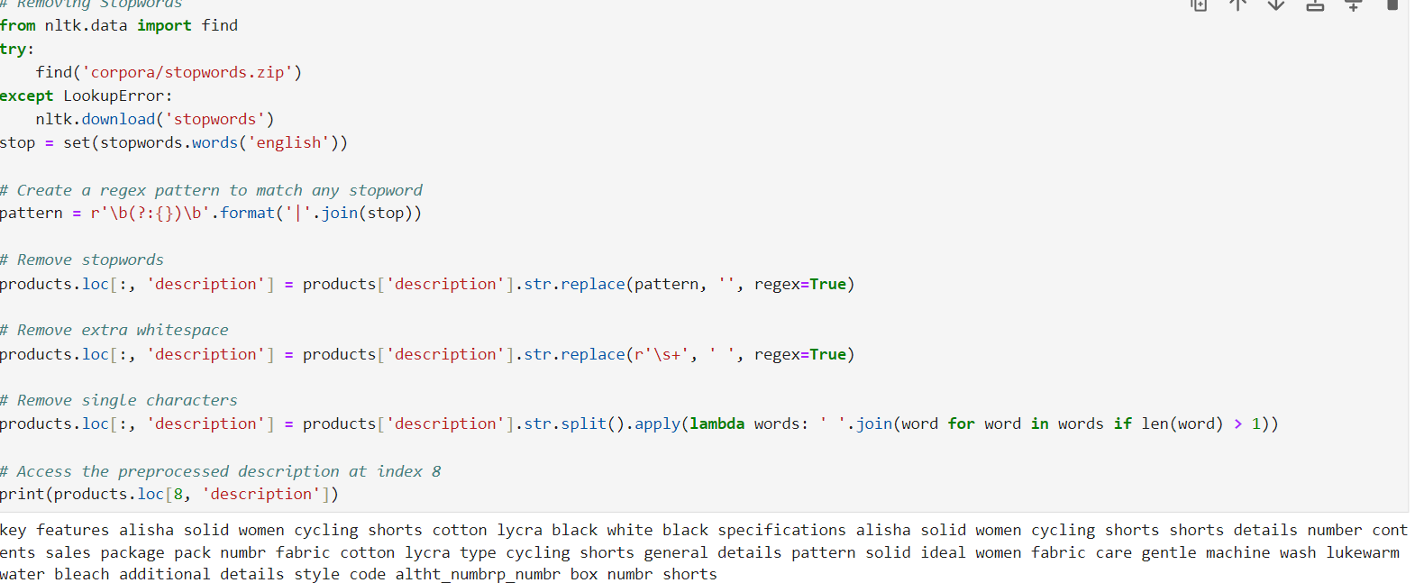
Removal of stopwords

Slide 9
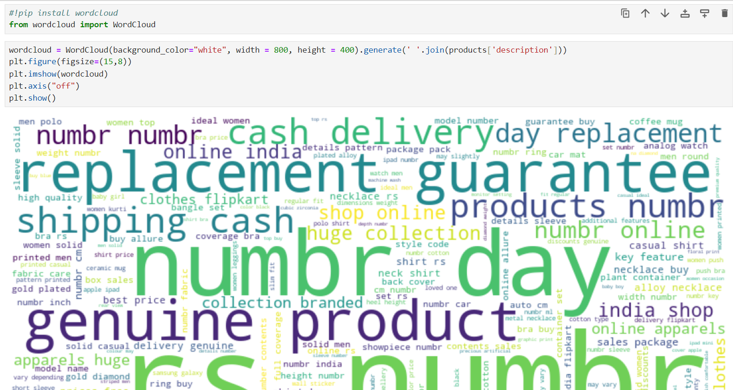
wordcloud

Slide 10
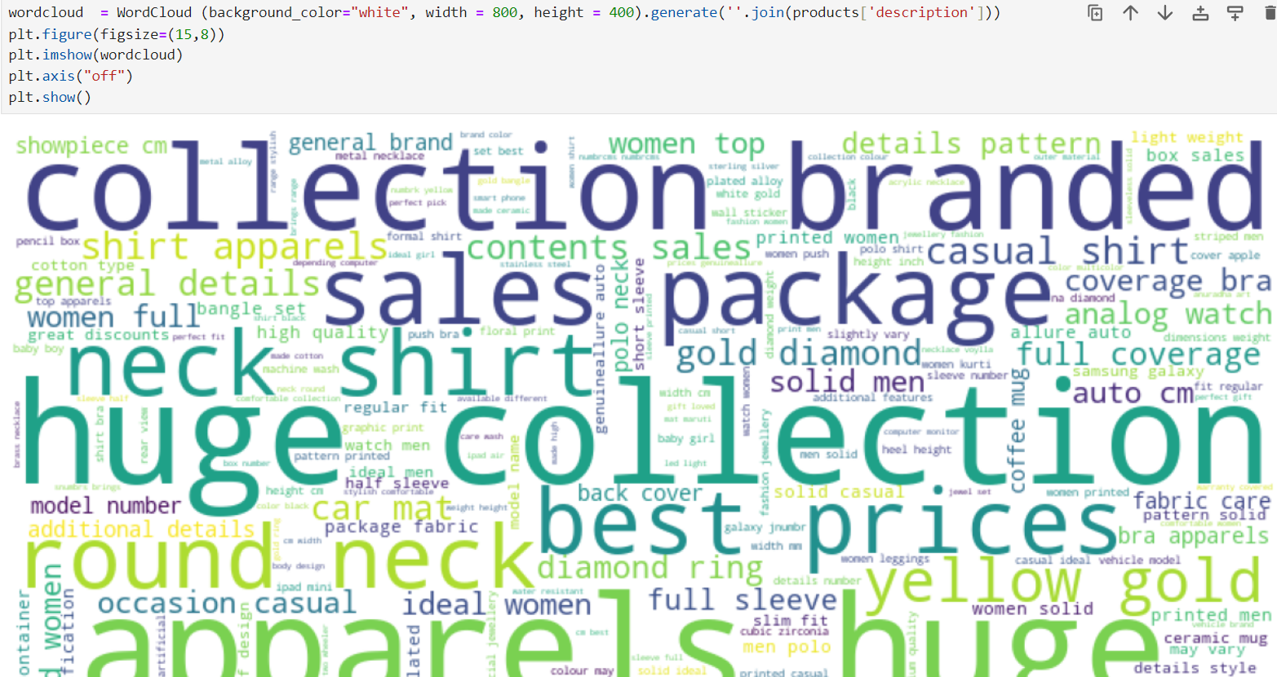

Slide 11
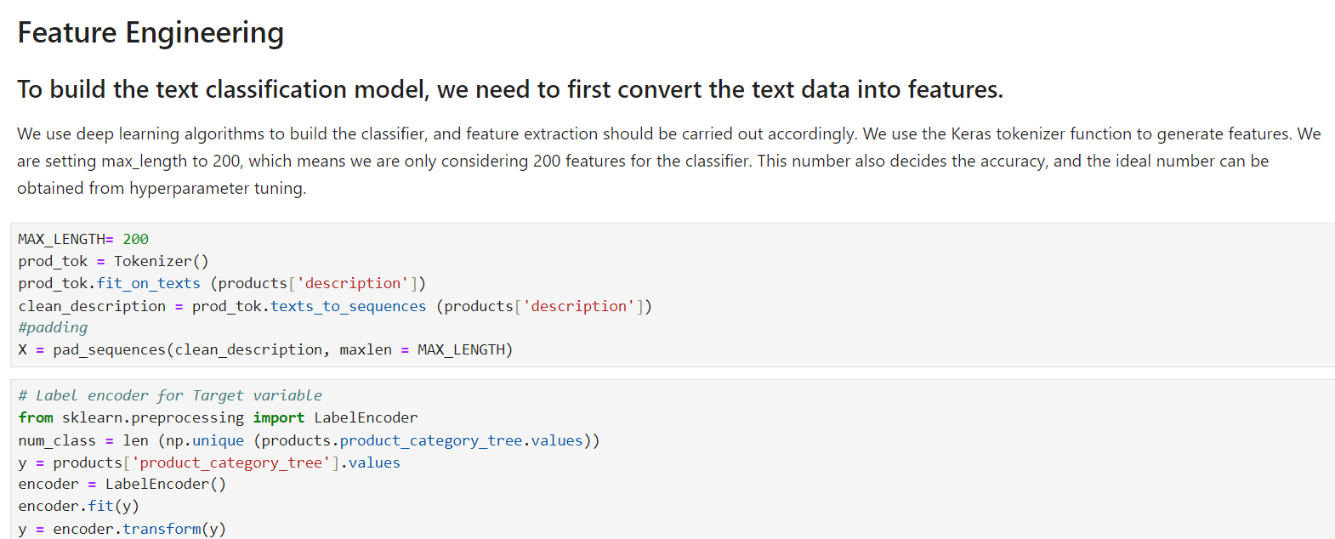

Slide 12
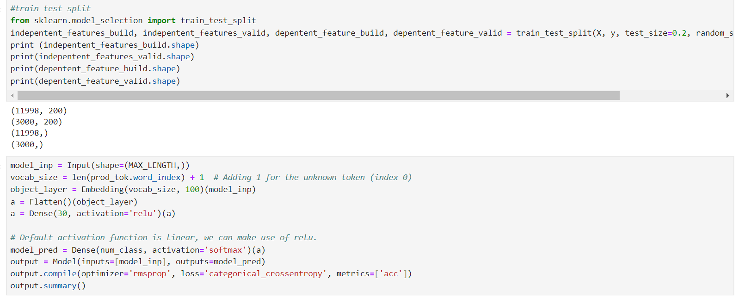
Train Test split

Slide 13
Building a Text Classification Model with Keras (ANN Model)
1. Model Input and Embedding Layer:
Input Layer:
Defines the shape of the input sequences (MAX_LENGTH).
Vocabulary Size:
Calculates the vocabulary size, adding 1 for the unknown token.
Embedding Layer:
Maps input tokens to dense vectors of size 100.
2. Flatten and Dense Layers:
Flatten Layer:
Converts the 2D matrix of embeddings into a 1D vector.
Dense Layer:
Fully connected layer with 30 neurons using ReLU activation.

Slide 14
Model summary and compilation
Output Layer:
Softmax Activation:
Outputs a probability distribution over the classes.
2. Model Compilation:
Compile the Model:
Uses RMSprop optimizer, categorical cross-entropy loss, and accuracy metric.

Slide 15
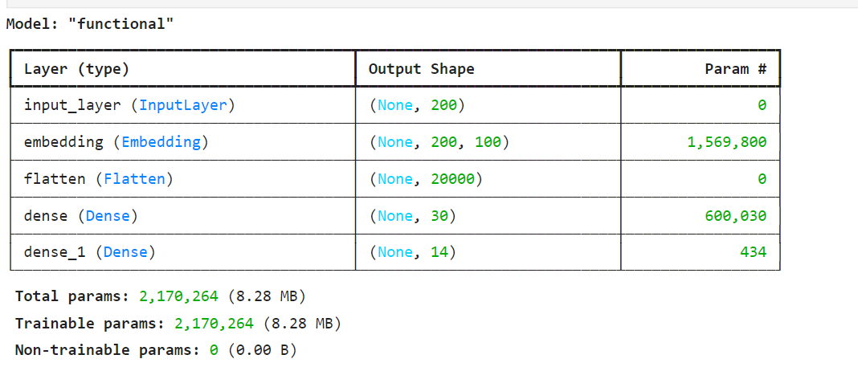
ANN Model Summary

Slide 16
LSTM MODEL OVERVIEW
1. Model Input and Embedding Layer:
Input Layer:
Defines the shape of the input sequences (MAX_LENGTH).
Embedding Layer:
Maps input tokens to dense vectors of size 100.
Vocabulary size calculated, including the unknown token.
2. LSTM Layer:
LSTM Layer:
Adds a Long Short-Term Memory (LSTM) layer with 60 units.
Captures temporal dependencies in the text data.

Slide 17
LSTM MODEL COMPILATION
1. Dense Layers:
First Dense Layer:
Adds a fully connected layer with 30 neurons (default activation is linear, can use ReLU).
2. Output Layer:
Softmax Activation:
Adds a final dense layer with softmax activation for multi-class classification.
3. Model Compilation:
Compile the Model:
Uses RMSprop optimizer.
Categorical cross-entropy loss function.
Accuracy as a metric.
4. Process Summary:
Define Input, Embedding, LSTM, Dense, and Output Layers.
Compile the Model.
Review Model Architecture.

Slide 18
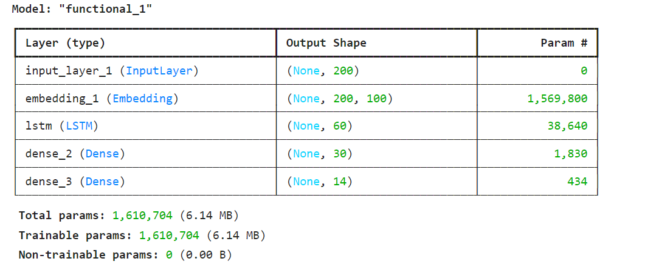
LSTM MODEL SUMMARY

Slide 19
CNN model Overview
Input Layer
Input layer with shape defined by MAX_LENGTH.
Embedding Layer
Embedding layer transforms input into dense vector representations of fixed size (100).
Convolutional Layer
Conv1D layer with 60 filters and a kernel size of 10.
Purpose: Extracts local patterns from the embedded input sequence.
Default activation: Linear (can be replaced with ReLU for non-linearity).
Pooling Layer
MaxPooling1D layer with a pool size of 2.
Purpose: Reduces the dimensionality of the feature map, focusing on the most prominent features
and reducing computational load.

Slide 20
Overview and compilation
LSTM Layer: LSTM layer with 60 units.
Purpose: Captures long-term dependencies and sequence information from the pooled features.Dense Layersa: Dense layer with 30 units.
Purpose: Fully connected layer to learn higher-level representations.
model_pred: Output dense layer with num_class units and softmax activation.
Purpose: Produces a probability distribution over the classes for classification tasks.Model Compilationoptimizer: RMSproploss function: Categorical Crossentropymetrics: Accuracy (acc)

Slide 21
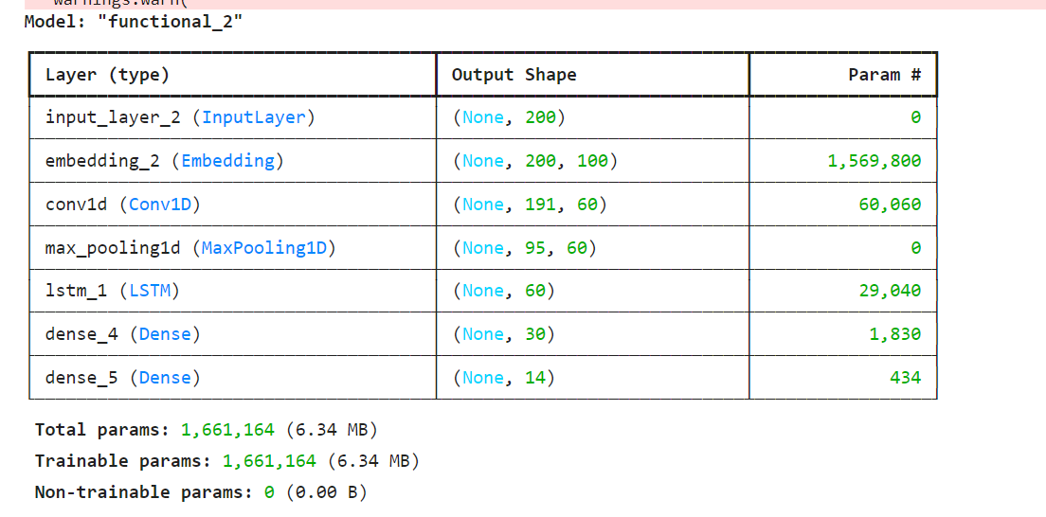
CNN Model Summary

Slide 22
Model prediction and evaluation
1. Loading Weights:
Load Best Weights:
Loads the best model weights saved during training.
2. Prediction on Validation Data:
Predict:
Uses the trained model to predict on validation data.
Converts predicted probabilities to class labels using ‘argmax’
3. Evaluation:
Accuracy Score:
Calculates the accuracy score of the model on the validation set.
Compares predicted labels to the true labels.

Slide 23
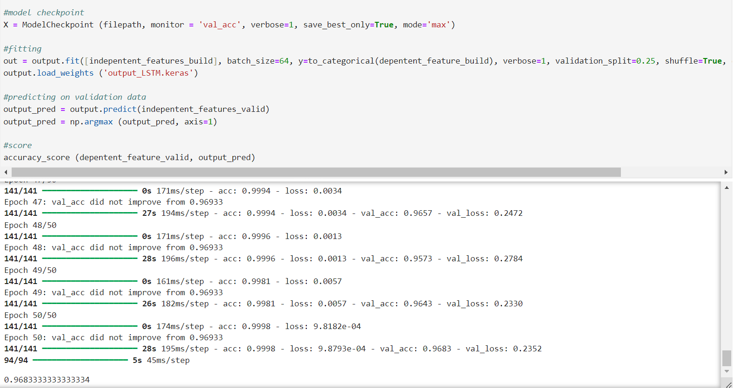
ANN MODEL

Slide 24
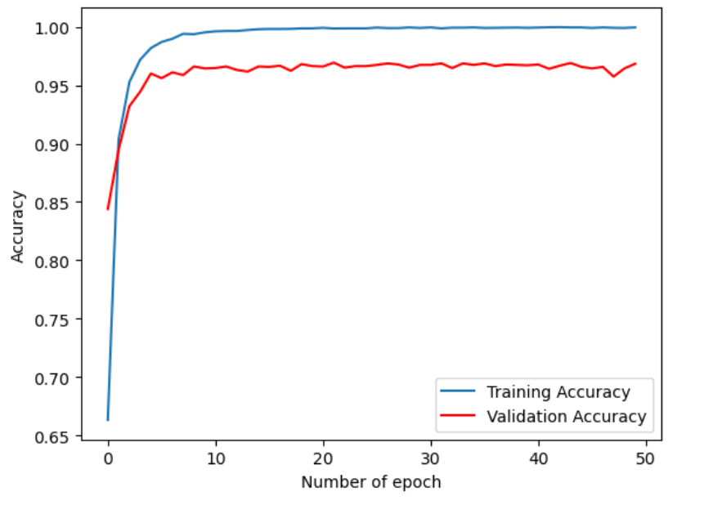
LSTM Model

Slide 25
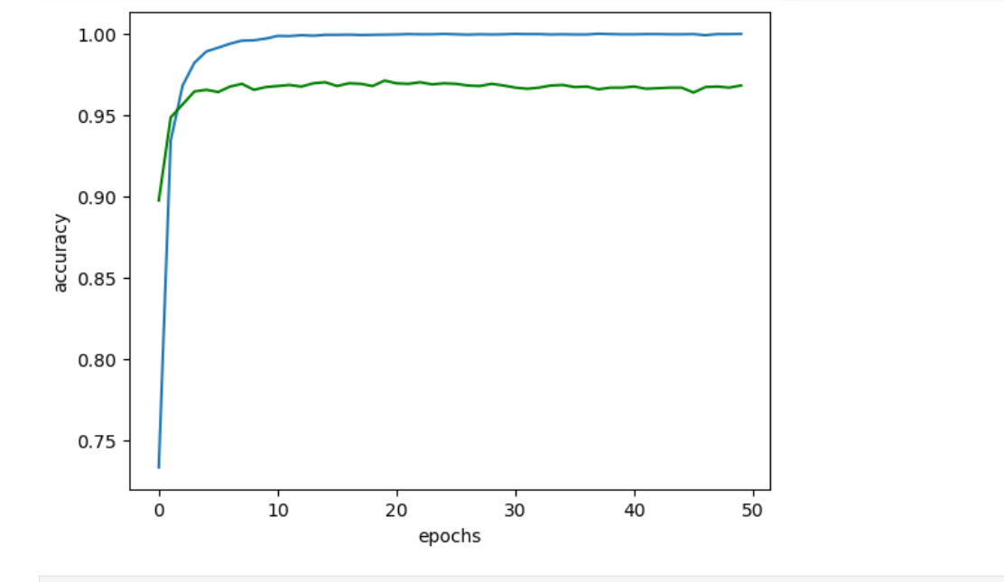
CNN model

Slide 26
THANKYOU

